Slide 1

Toward Black-box Image Extraction Attacks on RBF SVM Classification Model
Michael R. Clark, Andrew Alten, Peter Swartz, Raed M. Salih
Peter Swartz

Slide 2
Toward Black-box Image Extraction Attacks on RBF SVM Classification Model
Introduction
Motivation and Problem Statement
Preliminary Attack Outline
Preliminary Attack
Mathematical Explanations
Attacks Variations
Attack Results
Attack Analysis
Conclusions and Future Work

Slide 3

Introduction
Protecting Machine Learning (ML) models
  Models trained on sensitive information can leak information.
The primary attack classes against ML models
  deception (a.k.a. adversarial examples), model inversion, training data extraction, and membership inference.
  white-box, gray-box, or black-box access
Vector Machines (SVMs)
  image classification.

Slide 4
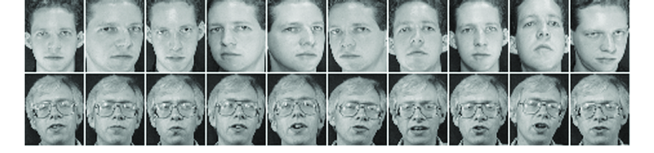
Introduction
Training data extraction attacks
  Training-based
  Optimization-based.
Extraction of semantically meaningful images
  the number of training images is low,
  the inter-class diversity of the images is also low,
    Ex: images of the face of the same individual.
AT&T Face Database Example

Slide 5
Motivation and Problem Statement
Defenses for the various attack (in the literature)
  Quickly broken or fail to defend
    against realistic adversaries.
  Attacks have not been fully researched and understood
    How classifiers under attack behave?
The research aims
  Demonstrate black-box image extraction attacks
  Develop a deep understanding
    Why some trained ML models are vulnerable/others are not
  Shows attacks can extract meaningful information
    More than an “average” of each class.
The research presents
  Black-box training data extraction attack
    On RBF SVM/image classification
  Model for understanding
    Why the proposed attack is successful on the RBF SVM classifier?

Slide 6
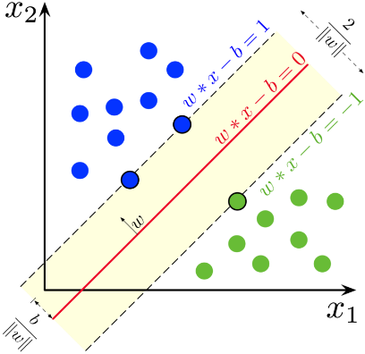
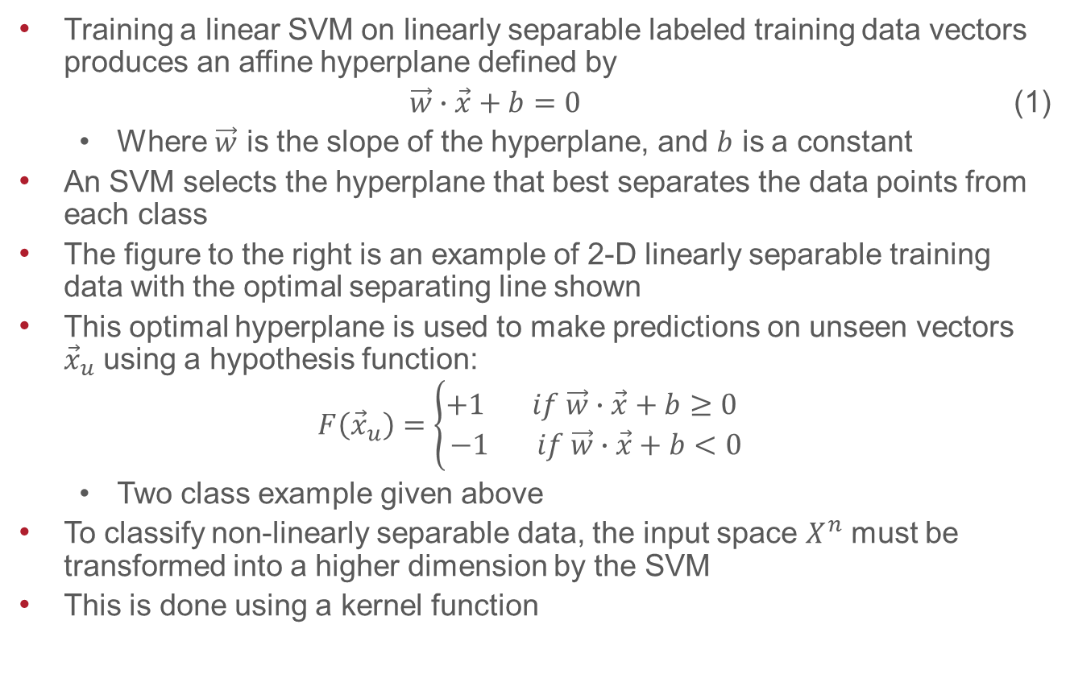
Preliminary Attack Outline
Training a linear SVM on linearly separable labeled training data vectors produces an affine hyperplane defined by
$\vec{w}∙\vec{x}+b=0$ (1)
  Where $\vec{w}$ is the slope of the hyperplane, and $b$ is a constant
An SVM selects the hyperplane that best separates the data points from each class
The figure to the right is an example of 2-D linearly separable training data with the optimal separating line shown
This optimal hyperplane is used to make predictions on unseen vectors ${\vec{x}}_{u}$ using a hypothesis function:
$$F\left({\vec{x}}_{u}\right)=\left\{\begin{aligned}+1 if \vec{w}∙\vec{x}+b≥0 \\ −1 if \vec{w}∙\vec{x}+b<0\end{aligned}\right.$$
  Two class example given above
To classify non-linearly separable data, the input space $X^{n}$ must be transformed into a higher dimension by the SVM
This is done using a kernel function
https://en.wikipedia.org/wiki/Support_vector_machine

Slide 7
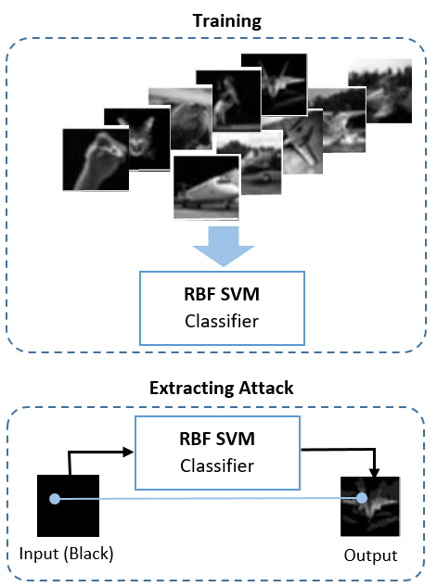
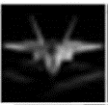

Preliminary Attack
The preliminary attack
  Iterating over the pixels of a blank image
    the same size as the training images for the classifier.
  attacker finds the pixel value
    Maximizes the classifier’s confidence (belongs to a specific class)
  Iterating over all of the pixels
    the discovered image is returned.
a = n x m matrix of all zeros
for i = 0 to n
for j = 0 to n
bestScore = CLASSIFIER(a)
bestValue = 0
for k = 0 to 256
a[i][j] = k
currentScore = CLASSIFIER(a)
if currentScore >= bestScore
bestScore = currentScore
bestValue = k
a[i][j] = bestValue
return a

Slide 8
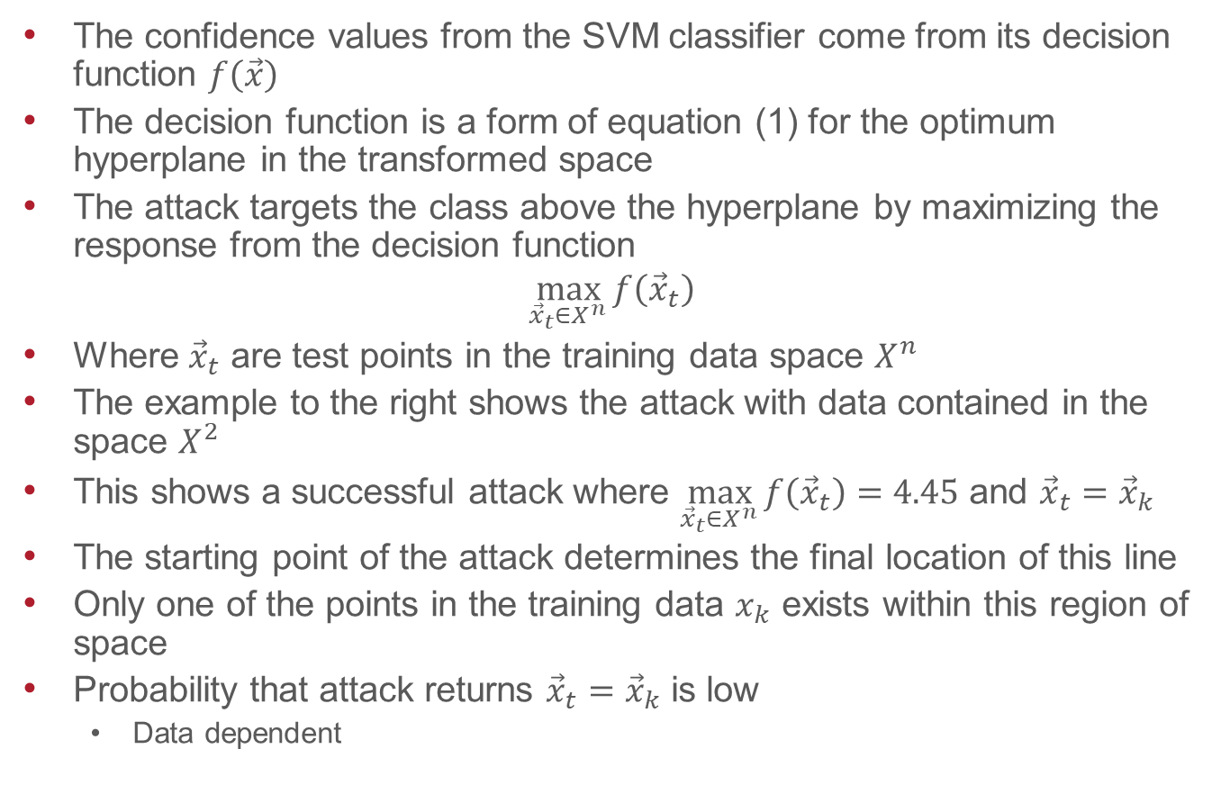
Mathematical Explanations – Linear Classifier
The confidence values from the SVM classifier come from its decision function $f\left(\vec{x}\right)$
The decision function is a form of equation (1) for the optimum hyperplane in the transformed space
The attack targets the class above the hyperplane by maximizing the response from the decision function
$$\max_{{\vec{x}}_{t}∈X^{n}}{f\left({\vec{x}}_{t}\right)}$$
Where ${\vec{x}}_{t}$ are test points in the training data space $X^{n}$
The example to the right shows the attack with data contained in the space $X^{2}$
This shows a successful attack where $\max_{{\vec{x}}_{t}∈X^{n}}{f\left({\vec{x}}_{t}\right)}=4.45$ and ${\vec{x}}_{t}={\vec{x}}_{k}$
The starting point of the attack determines the final location of this line
Only one of the points in the training data $x_{k}$ exists within this region of space
Probability that attack returns ${\vec{x}}_{t}={\vec{x}}_{k}$ is low
  Data dependent

Slide 9
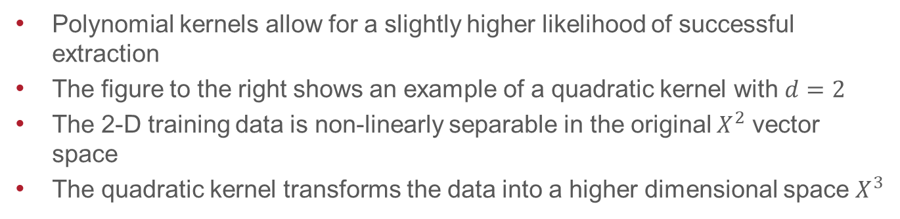
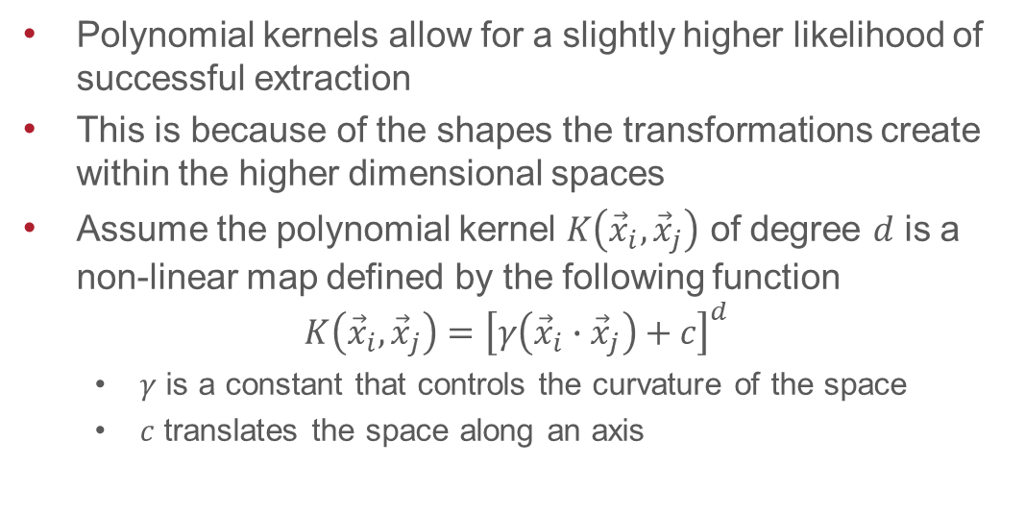
Mathematical Explanations – Polynomial Classifier
Polynomial kernels allow for a slightly higher likelihood of successful extraction
This is because of the shapes the transformations create within the higher dimensional spaces
Assume the polynomial kernel $K\left({\vec{x}}_{i},{\vec{x}}_{j}\right)$ of degree $d$ is a non-linear map defined by the following function
$$K\left({\vec{x}}_{i},{\vec{x}}_{j}\right)={\left[γ\left({\vec{x}}_{i}∙{\vec{x}}_{j}\right)+c\right]}^{d}$$
  $γ$ is a constant that controls the curvature of the space
  $c$ translates the space along an axis
(a)
(b)
Polynomial kernels allow for a slightly higher likelihood of successful extraction
The figure to the right shows an example of a quadratic kernel with $d=2$
The 2-D training data is non-linearly separable in the original $X^{2}$ vector space
The quadratic kernel transforms the data into a higher dimensional space $X^{3}$

Slide 10
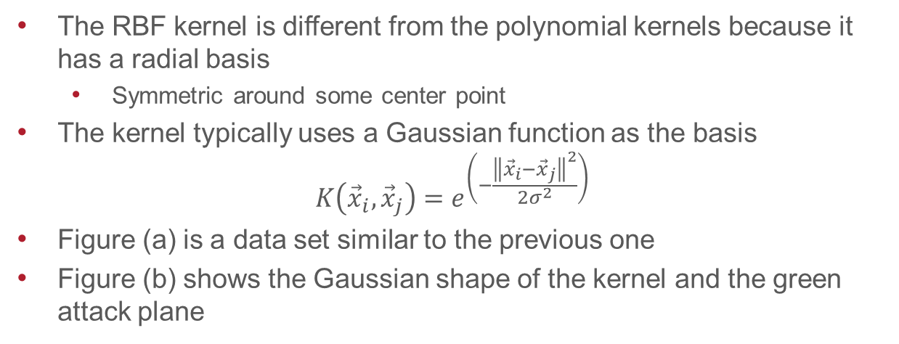
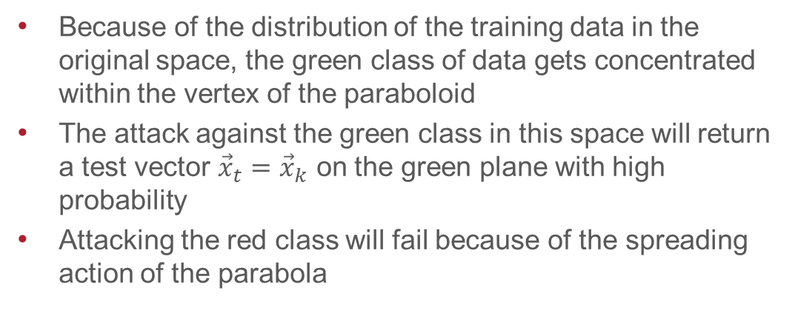
Mathematical Explanations – RBF Classifier
Because of the distribution of the training data in the original space, the green class of data gets concentrated within the vertex of the paraboloid
The attack against the green class in this space will return a test vector ${\vec{x}}_{t}={\vec{x}}_{k}$ on the green plane with high probability
Attacking the red class will fail because of the spreading action of the parabola
The RBF kernel is different from the polynomial kernels because it has a radial basis
  Symmetric around some center point
The kernel typically uses a Gaussian function as the basis
$$K\left({\vec{x}}_{i},{\vec{x}}_{j}\right)=e^{\left(−\frac{{\left\|{\vec{x}}_{i}−{\vec{x}}_{j}\right\|}^{2}}{2σ^{2}}\right)}$$
Figure (a) is a data set similar to the previous one
Figure (b) shows the Gaussian shape of the kernel and the green attack plane
(a)
(b)

Slide 11
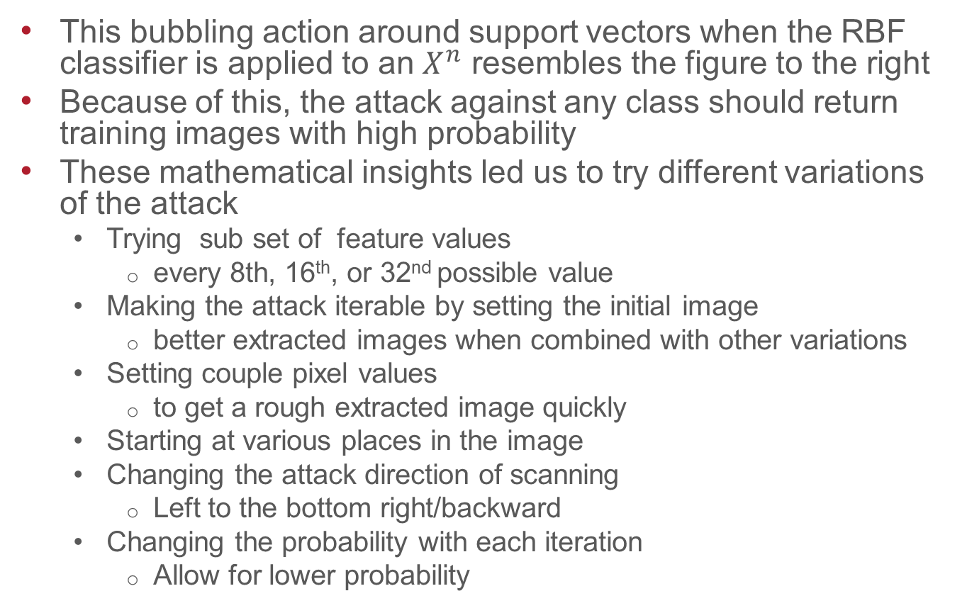
Attack Variations
This bubbling action around support vectors when the RBF classifier is applied to an $X^{n}$ resembles the figure to the right
Because of this, the attack against any class should return training images with high probability
These mathematical insights led us to try different variations of the attack
  Trying sub set of feature values
    every 8th, 16th, or 32nd possible value
  Making the attack iterable by setting the initial image
    better extracted images when combined with other variations
  Setting couple pixel values
    to get a rough extracted image quickly
  Starting at various places in the image
  Changing the attack direction of scanning
    Left to the bottom right/backward
  Changing the probability with each iteration
    Allow for lower probability
Martin D Buhmann, Stefano De Marchi, and Emma Perracchione. 2019. Analysis of a new class of rational RBF expansions

Slide 12
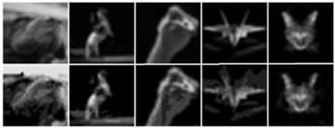
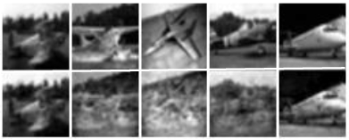
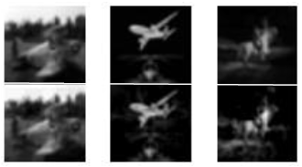
Attack Results
Single Image Extraction Results from a Single Model
Multiple Images Extracting Results from a Single Model
Training Image
Extracted Image
Training Image
Extracted Image
Images extracted from RBF SVM classifier trained on 200 images per class from CIFAR-10
Five image extracted from a single RBF SVM model trained on 2,000 images per class
Training Image
Extracted Image
Images extracted from RBF SVM classifier trained on 2,000 images per class from CIFAR-10

Slide 13
Attack Analysis
We extract meaningful images
  highly similar to a single training image (not just the average of the training images).
We were able to recover images even on models trained on thousands of images per class
Our preliminary attack was most successful on the CIFAR-10 dataset.
  where the inter-class diversity is high

Slide 14
Conclusions and Future Work
Conclusions
Highly successful black-box training data extraction attack (on RBF SVM )
Our preliminary attack extract semantically meaningful images
Future Work
Train SVM on raw pixel images and study feature extraction methods.
Test our attack effectiveness in a more practical context
  HOG method & L2 hysteresis (L2-hys) normalization technique.
Run Our attack on:
  SVMs with linear, quadratic, and cubic kernels
    To test its ability to extract training data.
  Other datasets (Fashion MNIST& CIFAR-100).
  A neural network model

Slide 15
Closing
Thanks
Dr. Michael Clark
Dr. Raed Salih
Mr. Andrew Alten
Contact Information
Riverside Research
Beavercreek, OH, United States
{mclark,pswartz,rsalih}@riversideresearch.org

